Slide 1
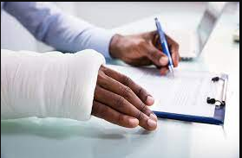
Types Of Personal Injury And Accident Cases:

Slide 2
What is Personal Injury Action? A personal injury cause of action is a set of facts that entitles a person to pursue monetary compensation for their accident-related losses. This type of lawsuit is a form of legal action known as a tort. This action is unlike criminal cases that can lead to jail time or fines.

Slide 3
Types Of Personal Injury And Accident Cases: 1.Motor Vehicle Accidents 2. Medical Malpractice 3. Premises liability 4.Product liability 5. Catastrophic Injuries

Slide 4
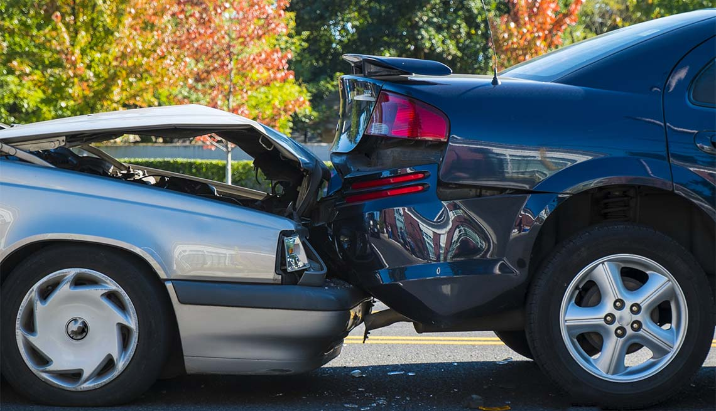
1.Motor Vehicle Accidents Motor vehicle accidents – including auto, large truck, pedestrian, bike, and motorcycle accidents. Auto accident claims often devolve into he-said, she-said, scenarios. That’s where an experienced personal injury attorney can use trial and negotiating experience, find evidence, and leverage relationships to get the best possible outcome for your case. The accident involved drunk driving, speeding, or reckless driving etc.

Slide 5
2. Medical Malpractice
When medical professionals fail to provide a reasonable standard of care, the results can be devastating for patients and their families. Medical negligence refers to the imprudent action (or failure to act) that directly contributed to the patient’s injury. Medical malpractice can result in catastrophic injuries (including organ failure, brain, and spinal cord injury) and even death. It includes surgical errors, misdiagnosis/failure to diagnose, defective and dangerous drugs, birth injury, cerebral palsy, and bed sores of elder in nursing home.

Slide 6
3. Premises Liability
Premises liability law pertains to injuries, including slip and fall injuries, caused by unsafe premises. The law requires that property owners maintain the safety of their property. When they fail to do so and their failure causes injury to a visitor, the property owner can be held liable for the injury. Other premises liability claims also includes workplace accidents.

Slide 7
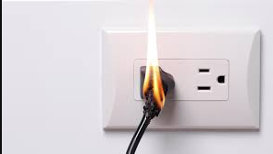
4.Product Liability
According to the doctrine of product liability, any or all parties involved in the design, manufacture, and marketing of a defective product may be held responsible for whatever injuries result from the use of the product. These parties must take reasonable measures to ensure that a product does not pose any unforeseeable hazards to consumers when used for its intended purpose. Product liability – including injuries caused by defective products or dangerous toys.

Slide 8
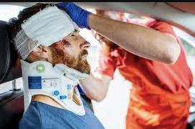
5. Catastrophic Injuries
A catastrophic injury is a physical injury or illness that is regarded as extreme or particularly serious, has a considerable impact on the victim of the injury or illness and needs a considerable amount of medical treatment. Catastrophic injuries may not always be permanent, but take months or years to heal.

Slide 9
Contact Our Sacramento Personal Injury Lawyers
If you or a loved one has suffered a serious injury, please call us toll-free at 800-939-1832 or complete a questionnaire for a free case evaluation with York Law Firm. Our experienced Sacramento personal injury lawyers have a proven record of achieving excellent results before a jury. We have played lead roles in achieving settlements and judgments on behalf of injured individuals and classes of victims in a combined amount of over $160 million.
Contact one of our Sacramento personal injury attorneys today.

